Slide 1
French Immersion Information Session

Slide 2
Welcome & Plan for the Session
Introduction
What is French Immersion?
SD 58 French Immersion Program
Benefits of French Immersion
Common Concerns
Supports available at School
How parents can support at home
Helpful Links for families

Slide 3

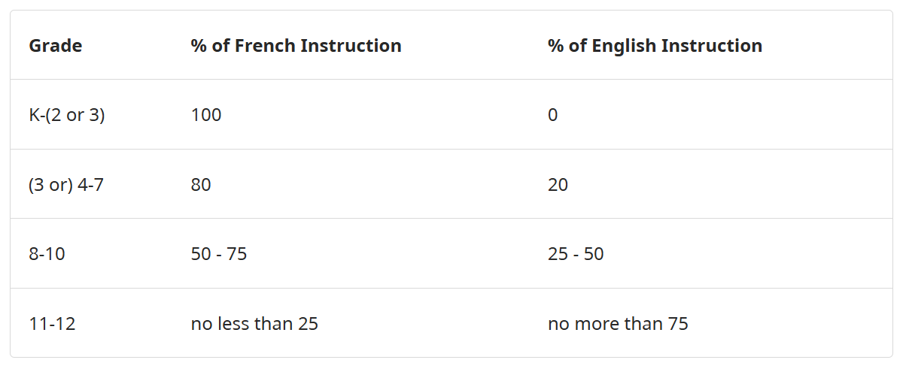
What Is French Immersion?
Early French Immersion
Provides the same educational program as the English stream.
Offers students the opportunity to develop a high level of French proficiency.
Entry is normally in Kindergarten (sometimes Grade 1).
By Grade 12, students should be able to:
  Participate easily in French conversations.
  Take post-secondary courses taught in French.
  Work in French-language workplaces.

Slide 4

SD 58 French Immmersion Program
Collettville
Kindergarten–Grade 2
Heavy focus on oral language, vocabulary development, routines, songs, games
Literacy foundations taught in French
Students will acquire a natural-sounding pronunciation
Grades 3–7
English is introduced as a subject
Continued development of reading + writing skills
Strong growth in comprehension
Students begin making cross-language connections

Slide 5
SD 58 French Immmersion Program
Merritt Secondary School
Grades 8-10
Academic language strengthens
More complex reading/writing tasks
Growth in confidence communicating in French
Grades 11–12
Final courses required for the French Immersion Dogwood Diploma
Strong bilingual competence
Opportunities for travel/exchanges, DELF exams, scholarships, and leadership roles

Slide 6
Opportunities AT Our School District
Carnaval Week
French Cultural Presentations & Field Trips
Grade 6/7 Québec Trip
French Immersion Dual Dogwood Ceremony

Slide 7
Benefits of French Immersion
Cognitive Benefits
Stronger executive functioning, problem-solving, flexibility in thinking
Enhanced literacy skills overall
Better focus and multi-tasking abilities
Academic Benefits
FI students perform as well as or better than non-FI peers in English by Grade 4/5
Broad vocabulary in two languages
Long-term academic resilience
Many scholarships target bilingual students
Cultural & Global Benefits
Appreciation of different cultures
Access to French-speaking communities across Canada and internationally
Opens doors for travel, study abroad, and employment
Career Advantages
Bilingualism is a major asset in:
Government
Education
Health care
Business and tourism
Law and public service

Slide 8
Common Concerns
“Will my child fall behind in English?”
No—English skills catch up and often surpass peers by Grades 4–5.
“What if my child struggles academically?”
Supports are in place just like English-track students.
Learning challenges can be supported in French.
“Does the program work if parents don’t speak French?”
Yes—90%+ of FI parents don’t speak French.

Slide 9

Supports Available At School
Learning assistance in French & English
One-to-One Reading in French & English
Accueil (Offered to students joining the program later than Gr 1
Resources for home reading (Raz-Kids, Je lis Je lis)
Online resources & apps (Mathletics – French platform)

Slide 10
How Parents Can Support—Even if They Don’t Speak French
Encourage reading in any language
Ask your child to explain their learning
Build routines around homework (Dictée, Home Reading, etc)
Focus on supporting learning habits, not the French language

Slide 11
Helpful Sites and Resources
British Columbia French Education - Networks & Support
BC French Education - Resources for Students, Families and Educators
Canadian Parents For French
Home - Canadian Parents for French

Slide 12
MERCI
Nicole Mackay-Smith
250-378-2230
nmacakay-smith@365.sd58.bc.ca

